Slide 1
Edge Testing Tool (ETT) Overview

Slide 2
ETT Overview
Description:
NIST developed a tool to test requirements and standards related to message transport and content specifications for the ONC 2014 & 2015 Editions. The tool, named the Edge Testing Tool (ETT), tests for adherence to Direct and Direct Edge protocols, Consolidated CDA (C-CDA) and other specifications. The Office of the National Coordinator now hosts and maintains the tool.
Used by:
ONC 2014/2015 Edition Health IT Certification
Links
https://ttpedge.sitenv.org - URL to access the tool
Google Group for announcements, updates, new releases, bug fixes, discussion, etc:
https://groups.google.com/forum/#!forum/edge-test-tool/topics

Slide 3
ETT (Edge Test Tool) – Usage Context
Source Edge
Source HISP
Destination HISP
Destination Edge
MT
MT
MT
MT
Legend:
HISP is sending messages to HISP
Direct Applicability Statement
Edge system is sending messages to a HISP
SMTP protocol or XDR protocol
HISP has to translate from Edge Protocol to Direct before sending to another HISP and vice versa
XDR/XDM for Direct specifies translation
HISP is sending messages to an Edge system
XDR, IMAP4, POP3, or SMTP
MT
End to End Message Tracking across all the different protocols

Slide 4
HISP Testing using ETT
ETT as Source Edge
Source HISP
(SUT)
ETT as Destination HISP
MT
MT
MT
ETT as Source HISP
Destination HISP
(SUT)
ETT as Destination Edge
MT
MT
MT
Criteria
170.315(h)(1)
Direct Applicability Statement + IG for Delivery Notification
170.315(h)(2)
Direct Applicability Statement + IG for Delivery Notification + XDR/XDM for Direct + Edge Protocols

Slide 5
HISP Testing using DCDT
Source or Destination HISP
(SUT)
DCDT Test Tool
Usage:
Only used for Direct Certificate Discovery Testing which is part of the Direct Applicability Statement. This aspect is not tested by the ETT.
Criteria
170.315(h)(1)
Direct Applicability Statement + IG for Delivery Notification
170.315(h)(2)
Direct Applicability Statement + IG for Delivery Notification + XDR/XDM for Direct + Edge Protocols

Slide 6
HISP Testing using ETT and TTT
ETT as Source Edge
HISP
(SUT)
TTT
Usage:
Only used for validation of XDR and XDM payloads
(XDR/XDM for Direct and XDR Edge Protocols)
170.315(h)(2)
Direct Applicability Statement + IG for Delivery Notification + XDR/XDM for Direct + Edge Protocols
Manually copy payload (XDR or XDM) from ETT into the TTT for validation.

Slide 7
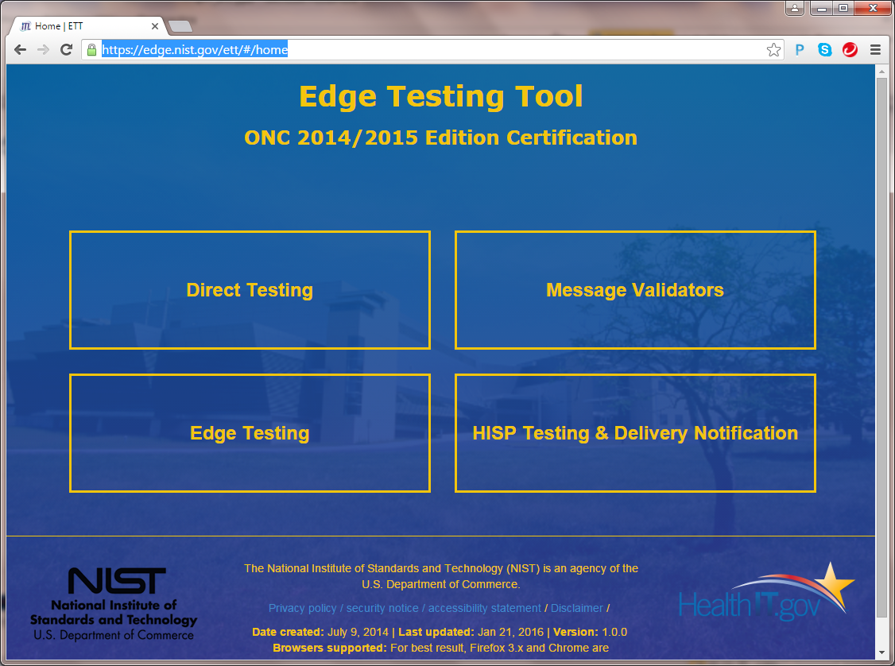
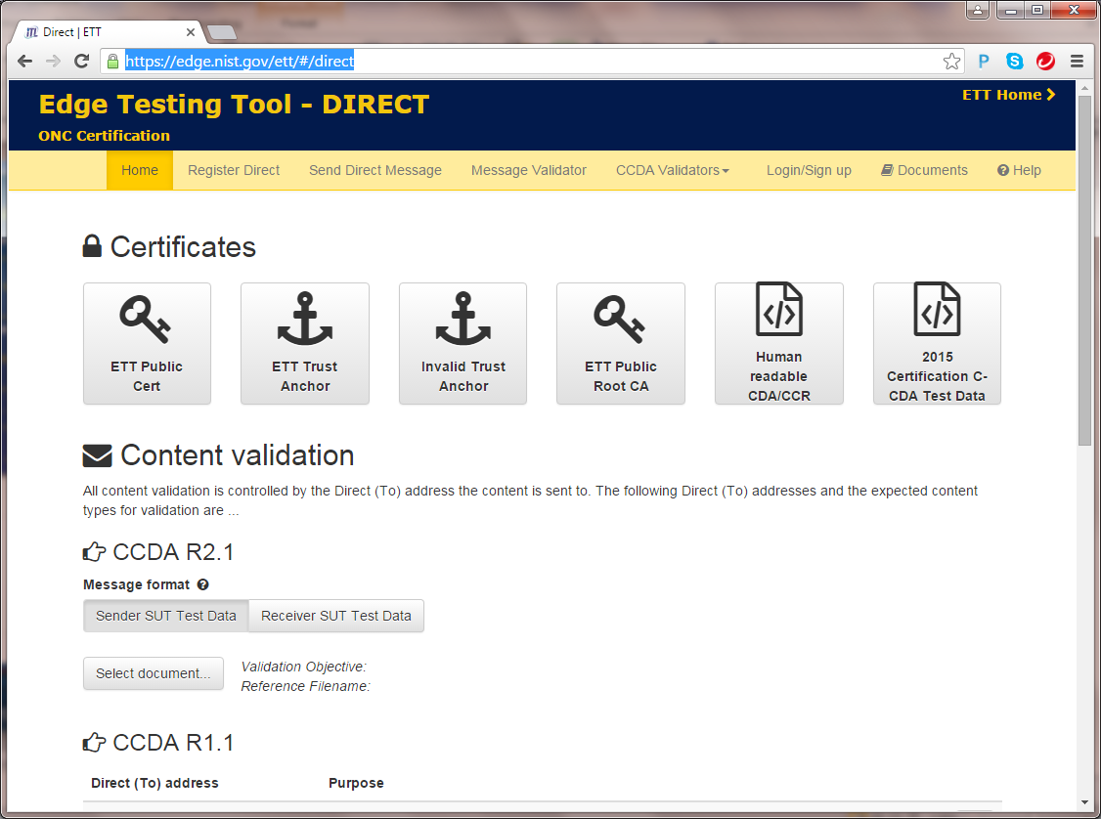
HISP Testing using ETT – Details for (h)(1),(h)(2) – Direct App Statement Testing

Slide 8
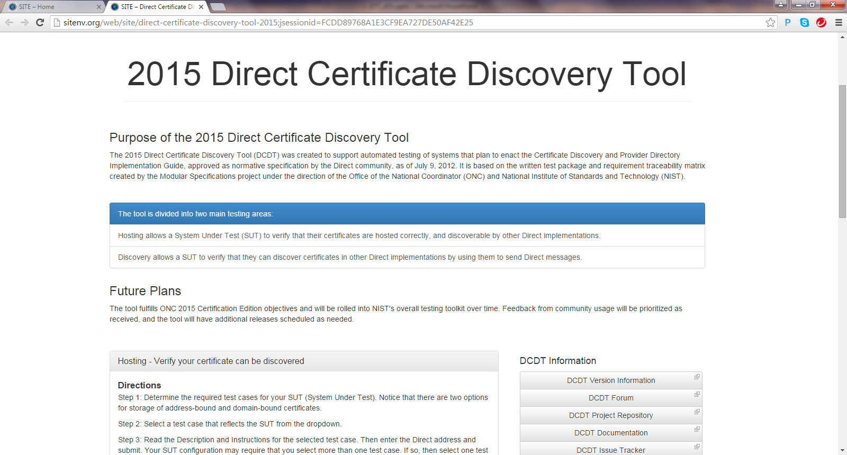
HISP Testing using DCDT for (h)(1), (h)(2) – Direct Certificate Discovery

Slide 9
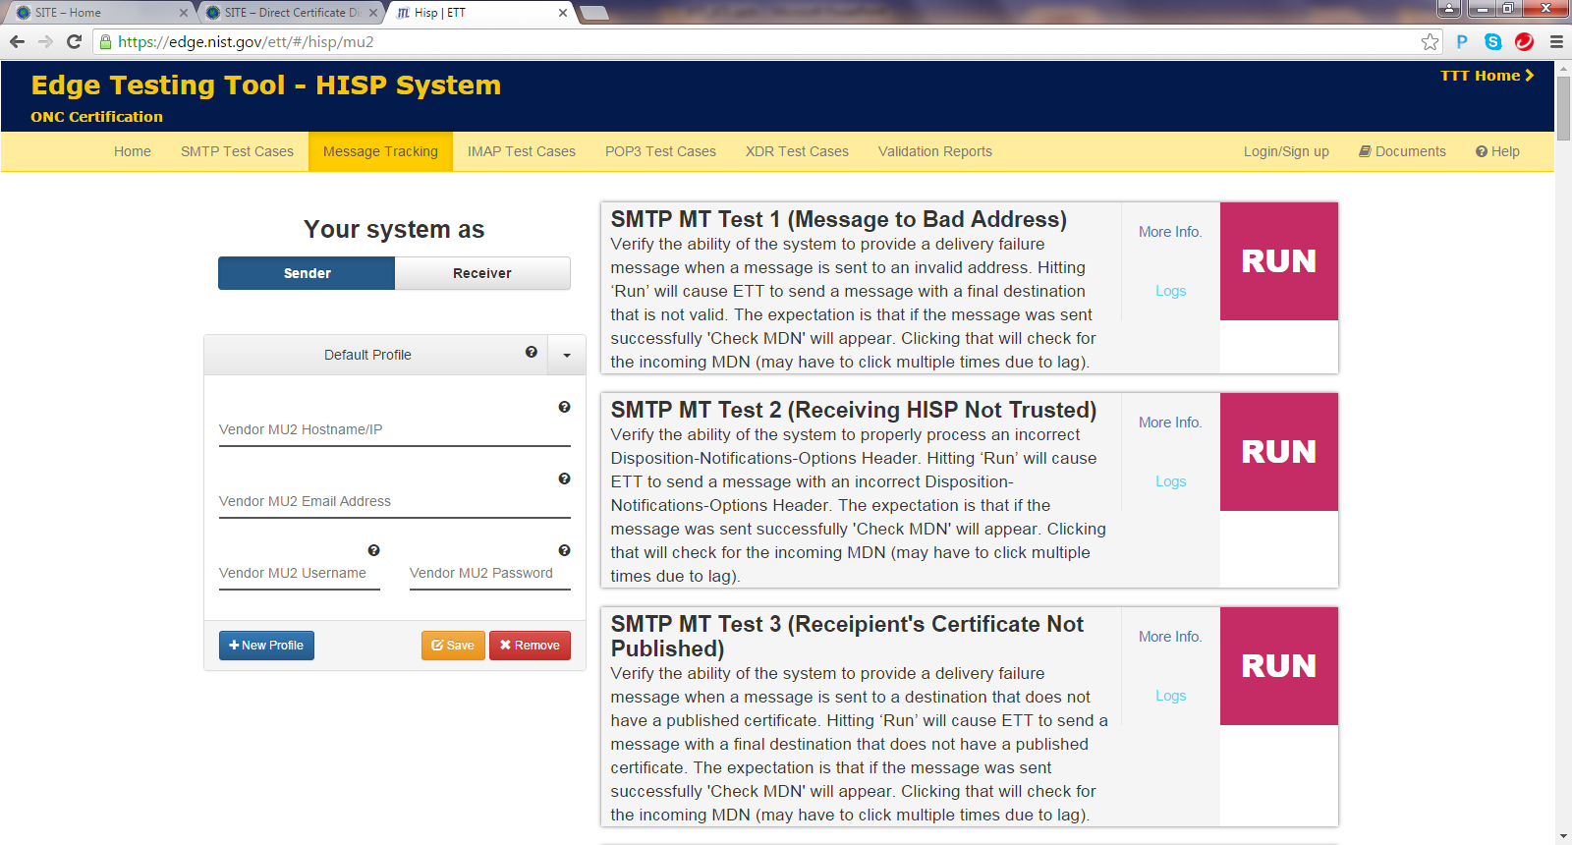
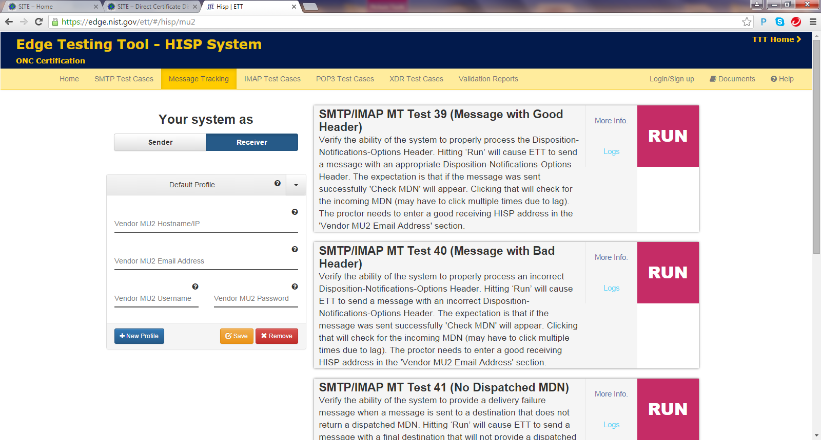
HISP Testing using ETT for (h)(1), (h)(2) – IG for Delivery Notification
Execute Test cases for Message Tracking from the Message Tracking and XDR Test Cases tabs

Slide 10
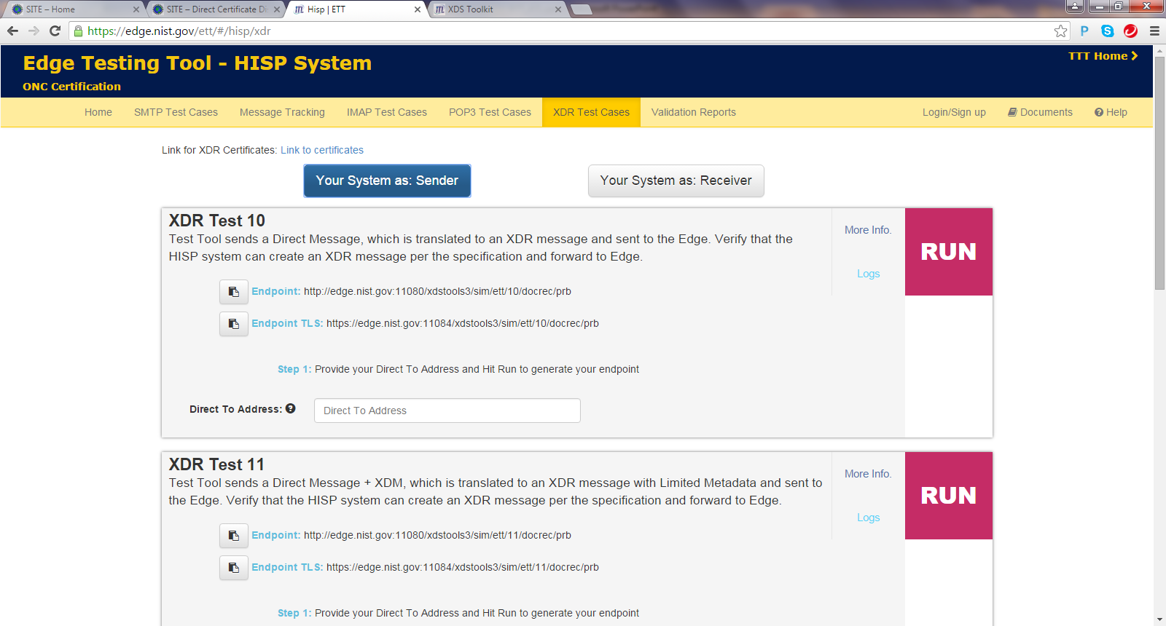
HISP Testing using ETT for (h)(2) – Edge Protocols
Execute each of the test cases listed next to the home menu following the Test Procedures
XDR
SMTP
Message Tracking
IMAP
POP3

Slide 11
Direct Edge Testing using ETT for (b)(1)
Source Edge (SUT)
ETT as Source HISP
MT
ETT as Destination HISP
Destination Edge
(SUT)
MT
Criteria
170.315(b)(1)
Transitions of Care document send/receive using Edge Protocols
Content validation and Payloads (XDM, C-CDAs) required for 170.315(b)(1) also supported by ETT using C-CDA validator

Slide 12
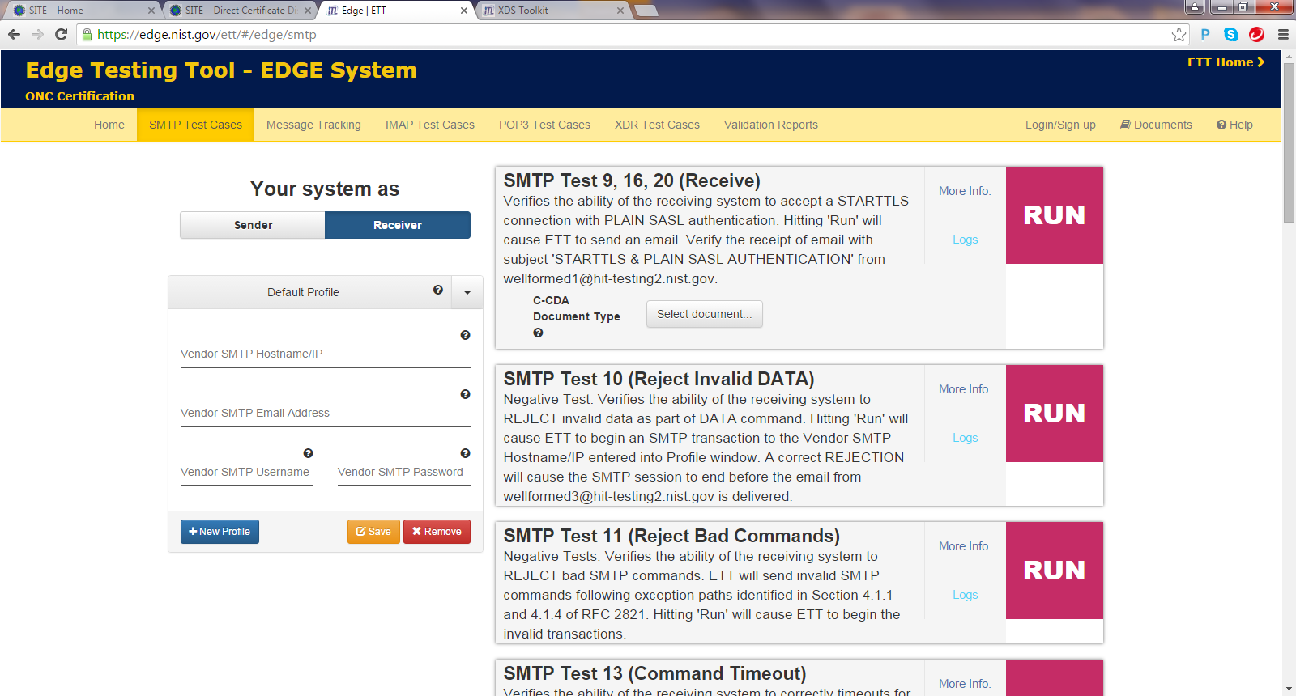
Edge Testing using ETT for (b)(1) – Edge Protocols
Execute each of the test cases listed next to the home menu following the Test Procedures
XDR
SMTP
Message Tracking
IMAP
POP3

Slide 13
Edge Testing using ETT and TTT
Edge (SUT)
ETT as HISP
TTT
Usage:
Only used for validation of XDR and XDM payloads
(XDR/XDM for Direct and XDR Edge Protocols)
170.315(b)(1)
Direct Edge Protocols
Manually copy payload (XDR or XDM) from ETT into the TTT for validation.

Slide 14
ETT (Edge Test Tool) – Message Validators
Purpose:
Many ONC 2015 Edition S&CC are content focused and do not require a specific transport protocol. These criteria are tested using Message Validators and are listed below
Criteria which generate C-CDA’s, and require testing of the generated C-CDA’s without using any transport protocols
170.315(b)(2) – Clinical Information Reconciliation (C-CDA created post reconciliation)
170.315(b)(4) – Common Clinical Data Set Summary Record – Create
170.315(b)(6) – Data Export
170.315(b)(7) – Data Segmentation for Privacy – Sender
170.315(b)(9) - Care Plan - Sender
170.315(e)(1) – View, Download and Transmit
170.315(g)(9) - Application Access All Data Request
Criteria which receive C-CDA’s for processing without using any transport protocols
170.315(b)(2) – Clinical Information Reconciliation (C-CDA created post reconciliation)
170.315(b)(4) – Common Clinical Data Set Summary Record – Receive
170.315(b)(9) - Care Plan - Receive
Negative Testing for CCDS
Negative Testing for CarePlan
Criteria which receive C-CDA generation instructions only from the Message Validators : 170.315(b)(1)

Slide 15
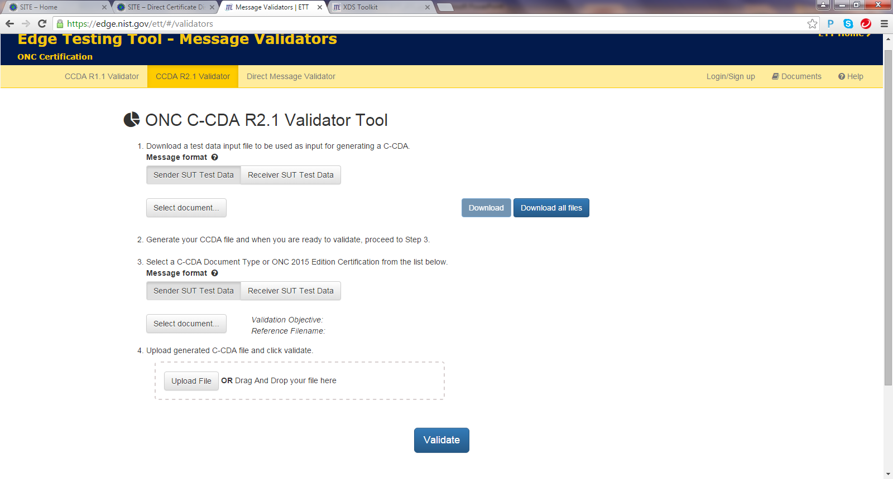
C-CDA Content Testing for (b)(2),(b)(4),(b)(6),(b)(7),(b)(9),(e)(1),(g)(9) using ETT Message Validators

Slide 16
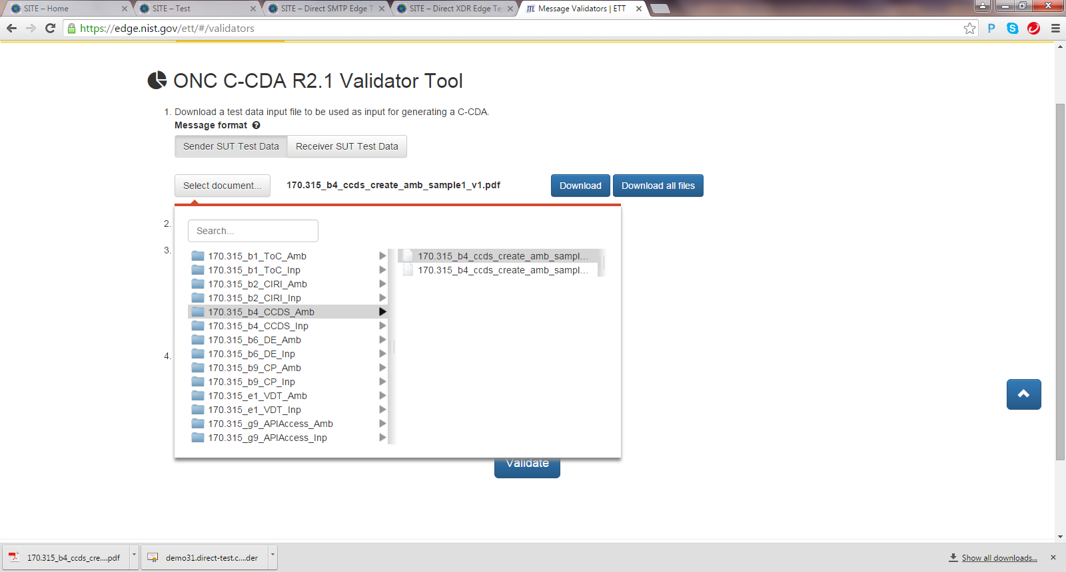
C-CDA Content Testing for (b)(2),(b)(4),(b)(6),(b)(7),(b)(9),(e)(1),(g)(9) using ETT Message Validators Cont’d

Slide 17
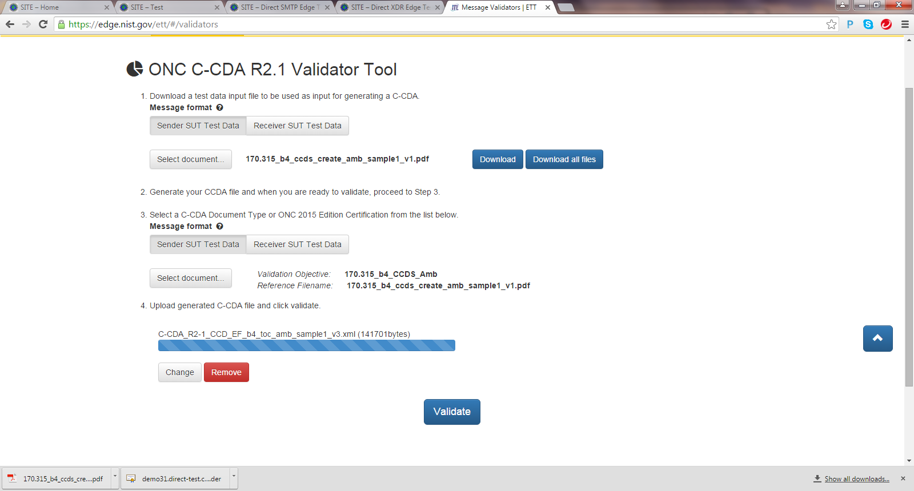
C-CDA Content Testing for (b)(2),(b)(4),(b)(6),(b)(7),(b)(9),(e)(1),(g)(9) using ETT Message Validators Cont’d

Slide 18
C-CDA Content Testing – Automated vs Visual Inspection
Automatic Validation comprises of 3 parts
C-CDA IG Conformance
Vocabulary Conformance
Gold Standard Match
Visual Inspection Components: (Annotated in the Test Instructions document explicitly)
For the certification criteria 170.315(b)(1),(b)(4),(b)(6), (e)(1), (g)(9) the following narrative only data elements will require visual inspection.
Assessment and Plan of Treatment
Goals
Health Concerns
Reason for Referral
Discharge Instructions (Discharge Summary only)
For DS4P criteria, all DS4P tags have to be visually inspected.

Slide 19
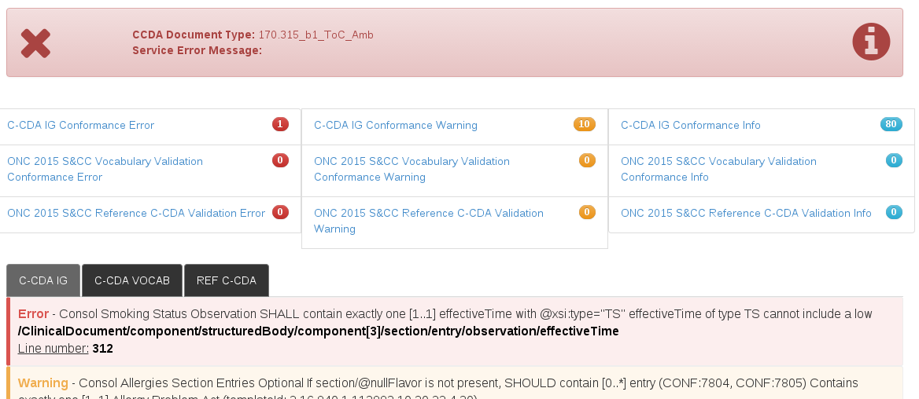
C-CDA Content Testing for (b)(2),(b)(4),(b)(6),(b)(7),(b)(9),(e)(1),(g)(9) using ETT Message Validators Cont’d
Validation report. Note the error report for missing effective Time in smoking status.

Slide 20
Slides from Previous Session

Slide 21
ETT Tool Testing: Message Validators
ETT: Message Validator CCDA R2.1 Validator SEND Download – Instructions | ETT: Message Validator CCDA R2.1 Validator SEND Upload – xml files from Create/Send
170.315(b)(1) – Transitions of Care (instructions) 170.315(b)(4) – Common Clinical Data Set Summary Record – create (instructions) 170.315(b)(6) – Data Export (instructions) 170.315(b)(9) Care Plan (instructions) 170.315(e)(1) – View Download Transmit (instructions) 170.315(g)(9) Application Access All Data Request (instructions) | 170.315(b)(2) – Clinical Information Reconciliation 170.315(b)(4) – Common Clinical Data Set Summary Record – create 170.315(b)(6) – Data Export 170.315(b)(7) – Data Segmentation for Privacy – Sender 170.315(b)(9) Care Plan 170.315(e)(1) – View Download Transmit 170.315(g)(9) Application Access All Data Request
ETT: Message Validator CCDA R2.1 Validator RECEIVE Download – xml files to Receive
170.315(b)(2) – Clinical Information Reconciliation (xml) 170.315(b)(5) – Common Clinical Data Set Summary Record – Receive | 170.315(b)(9) Care Plan Negative Testing for CCDS Negative Testing for Care Plan

Slide 22
ETT Tool Testing: Transport+
ETT: Edge Testing
170.315(b)(1) – Transitions of Care (send/receive Edge Protocol transport) 170.315(b)(1) – Transitions of Care (send/receive payload) 170.315(b)(1) – Transitions of Care (Receive XDM Package Validation)
ETT: Direct
170.315(h)(1) – Direct Project (send/receive Direct transport) 170.315(h)(2) – Direct Project, Edge Protocol, and XDR/XDM (send/receive Direct transport)**
ETT: HISP Testing and Delivery Notification | DCDT 2015
170.315(h)(1) – Direct Project (Message Tracking) 170.315(h)(2) – Direct Project, Edge Protocol, and XDR/XDM (Message Tracking) | 170.315(h)(1) – Direct Project (Certificates, Registering Direct Addresses) 170.315(h)(2) – Direct Project, Edge Protocol, and XDR/XDM (Certificates, Registering Direct Addresses)

Slide 23
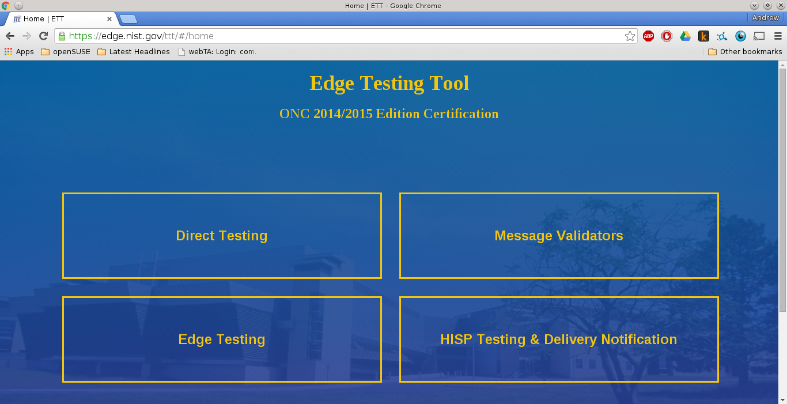
ETT Overview
https://ttpedge.sitenv.org

Slide 24
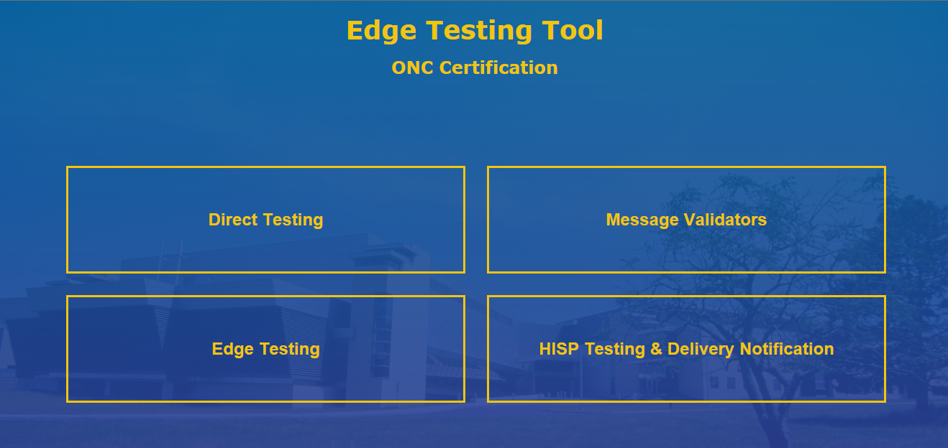
ETT -- Tool Access and Navigation
Objectives | Informative Reference
Establish access to the NIST Edge Testing tool (web application). Locate the Navigation options. Locate relevant documentation. (Note: Plan to have your documents ready for upload) | The NIST Test Suite is accessible through the following URL: https://edge.nist.gov/ . This displays the NIST ETT Test Suite’s Welcome Screen, which shows four options, “Direct Testing”, “Message Validation,” “Edge Testing,” and “HISP Testing & Delivery Notification”.
1
The tool’s Home Page offers Navigation to four components of the tool. The options are ‘Direct Testing’, ‘Message Validators’, ‘Edge Testing’, and ‘HISP Testing & Delivery Notification:’.
Each tab will direct you to the specified validation selection.

Slide 25
ETT Overview
Contains:
Direct protocol testing
Same engine from previous TTT tooling, moved to ETT with upgraded UI and features, better validation reporting, more items checked
Direct Edge protocol testing (for HISPs and Edge implementations)
SMTP
POP
IMAP
XDR
MDHT (Consolidated CDA) testing
XDM testing

Slide 26
ETT Overview
Google Group for announcements, updates, new releases, bug fixes, discussion, etc:
https://groups.google.com/forum/#!forum/edge-test-tool/topics

Slide 27
ETT Overview
What’s old:
Testing of Edge side of Direct Edge protocols
SMTP
XDR
Could be used for testing a HISP’s implementation of Direct Edge, but no tests specific for the HISP side
Direct Testing
MDHT R1.1

Slide 28
ETT Overview
What’s new:
More comprehensive negative testing
More enforcement of items that had not previously checked in Direct/MDN
Correct RFC 822 headers, including correct use of new lines and whitespace.
Flagging unwrapped messages
Ability to send unexpected MDN (i.e. sending a Displayed rather than Processed to check SUT for correct behavior)
etc.

Slide 29
ETT Overview
What’s new:
More comprehensive negative testing
Edge/C-CDA Testing
Ability to send more varied MIME/types (text/xml, application/xml, application/zip, application/octet-stream)
Multiple attachments in one transaction
Missing/malformed stylesheets
Sending invalid XDM packages
etc.

Slide 30
ETT Overview
What’s new (con’t):
Testing of HISP side of Edge Protocols
Basic HISP side testing existed in previous version, but many more additional test cases have been added. (Message Tracking.)
MDHT R2.1
Many more document types

Slide 31
ETT Overview
What’s new (cont’d):
Testing of Message Delivery functions based on:
Message Tracking Using Processed MDN
Implementation Guide for Delivery Notification
For both Edge testing and HISP testing additional optional Direct Edge protocols added
POP
IMAP

Slide 32
ETT Overview
ETT Components
Main ETT deployment
Java Spring Boot component (contains Tomcat)
mySQL database
Apache James (mail server)
MDHT component (Consolidated CDA validation)
Deploys under Tomcat
XDSTOOLS2 (for XD* functionality)
From TTT
Deploys under Tomcat

Slide 33
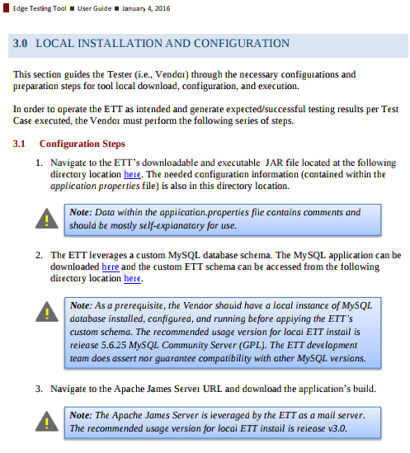
ETT Local Install
Local installation instructions include how to install the database schema in the mySQL instance.
Also discusses the Apache James (Java Apache Mail Enterprise Server) open source Java mail server instantiation used by ETT for SMTP, POP, IMAP.

Slide 34
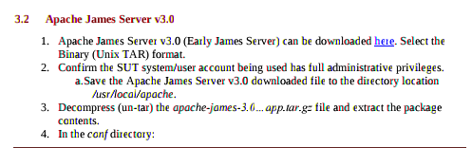
ETT Local Install
Apache James installation instructions (continued).

Slide 35
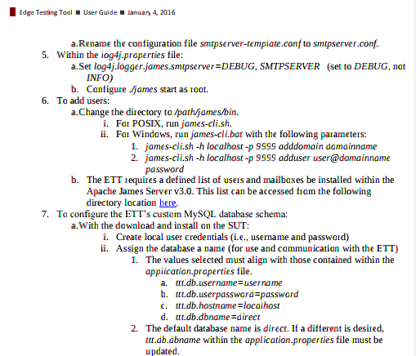
ETT Local Install

Slide 36
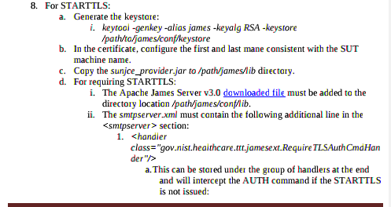
ETT Local Install
Note for proper STARTTLS functionality a custom library must added the the download Apache James 3 instance.
Without this library, it is possible for users to bypass the STARTTLS requirements.

Slide 37
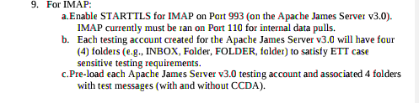
ETT Local Install
In the IMAP test cases, items will need to be fetched from the Apache James instance. Therefore the Apache James must be pre-loaded with the expected sample files for the vendor to discover. A link to the folder structure is included in the new version of the guide.

Slide 38
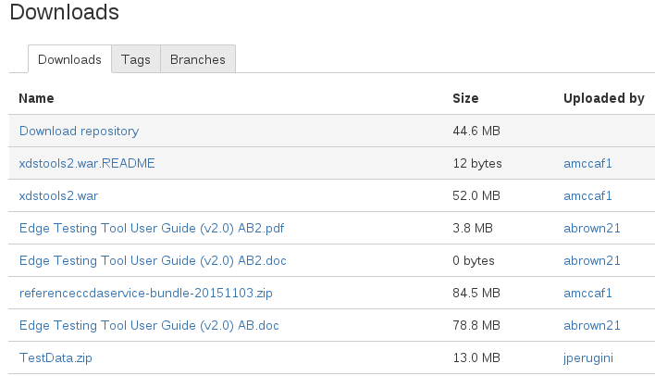
ETT Local Install -- MDHT
MDHT C-CDA Resource Bundle available to download from ETT downloads page (link in User Guide)
Filename: referenceccdaservice-bundle-LATEST_DATE.zip
ZIP Archive contains documentation for local installation and deployment.

Slide 39
ETT Local Install -- XDSTOOLS2
XDSTOOLS2 utility available to download from ETT downloads page (link in User Guide)
README also available for local installation and deployment information.

Slide 40
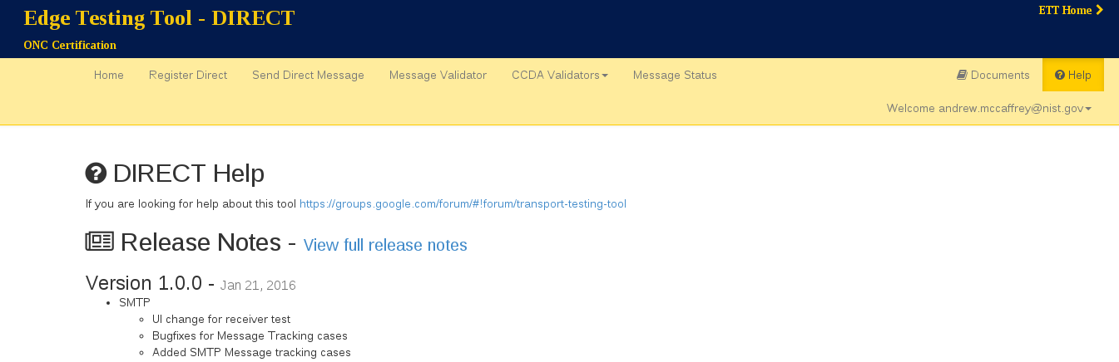
ETT -- Release Notes
Release notes are available under the “Help” tab.

Slide 41
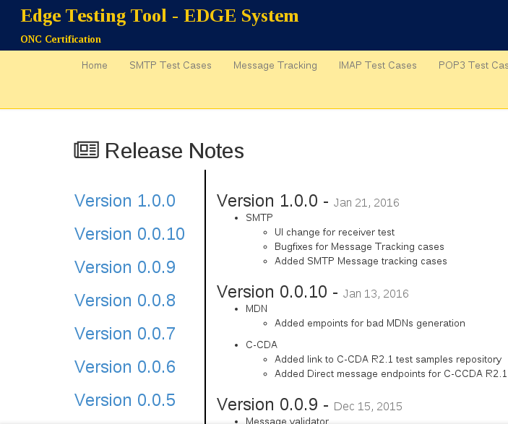
ETT -- Release Notes
Full release notes.

Slide 42
Using the ETT

Slide 43
MDHT Validator

Slide 44
ETT Tool Testing: Message Validators
ETT: Message Validator CCDA R2.1 Validator SEND Download – Instructions | ETT: Message Validator CCDA R2.1 Validator SEND Upload – xml files from Create/Send
170.315(b)(1) – Transitions of Care (instructions) 170.315(b)(4) – Common Clinical Data Set Summary Record – create (instructions) 170.315(b)(6) – Data Export (instructions) 170.315(b)(9) Care Plan (instructions) 170.315(e)(1) – View Download Transmit (instructions) 170.315(g)(9) Application Access All Data Request (instructions) | 170.315(b)(2) – Clinical Information Reconciliation 170.315(b)(4) – Common Clinical Data Set Summary Record – create 170.315(b)(6) – Data Export 170.315(b)(7) – Data Segmentation for Privacy – Sender 170.315(b)(9) Care Plan 170.315(e)(1) – View Download Transmit 170.315(g)(9) Application Access All Data Request
ETT: Message Validator CCDA R2.1 Validator RECEIVE Download – xml files to Receive
170.315(b)(2) – Clinical Information Reconciliation (xml) 170.315(b)(5) – Common Clinical Data Set Summary Record – Receive | 170.315(b)(9) Care Plan Negative Testing for CCDS Negative Testing for Care Plan

Slide 45
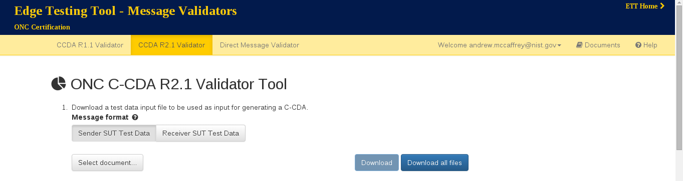
ETT Overview -- MDHT
To retrieve instructions for a C-CDA to be created by the vendor, first click on “Sender SUT Test Data”. Then select the criteria... (Alternatively available as a “Download all files” .zip archive.)

Slide 46
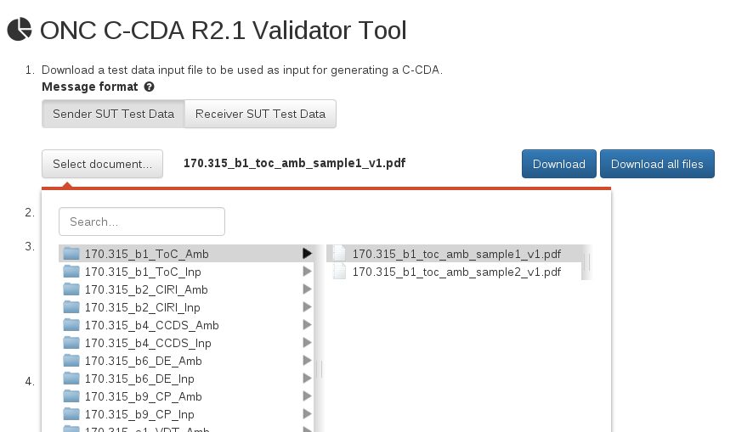
ETT Overview -- MDHT
They selected (b)(1) Transitions of Care, Ambulatory, first sample and can now download it.

Slide 47
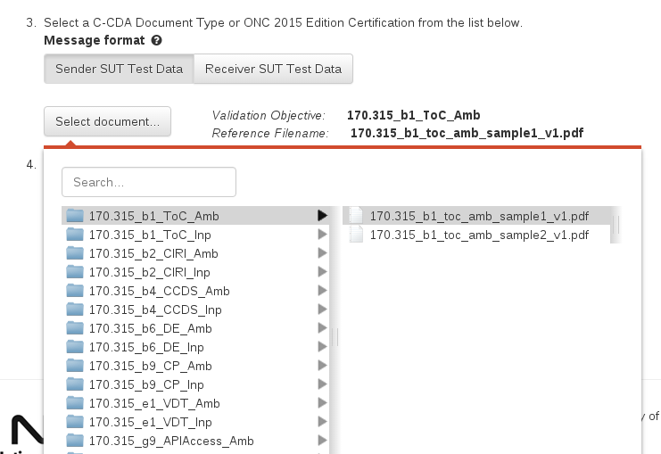
ETT Overview -- Direct
When they have created the C-CDA based on the downloaded PDF, it can be checked on the same page at the bottom. They select what they wrote against: (b)(1) Transitions of Care, Ambulatory #1.

Slide 48
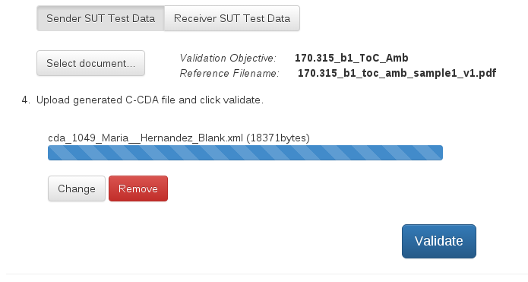
ETT Overview -- MDHT
Upload file, hit validate.

Slide 49
ETT Overview -- MDHT
Validation report. Note the error report for missing effective Time in smoking status.

Slide 50
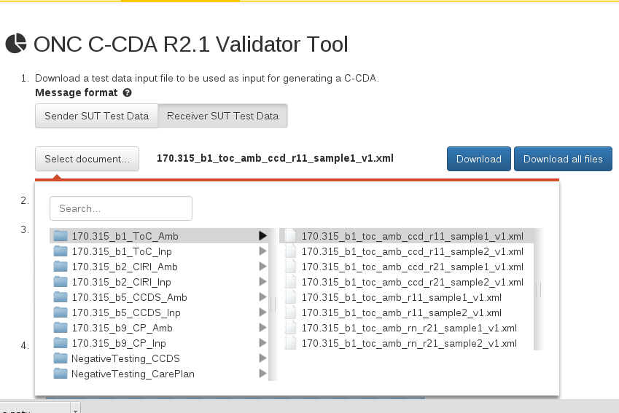
ETT Overview -- Direct
To download receiver information relevent to these criteria, there is a receiver button to click to download sample files (includes negative testing).

Slide 51
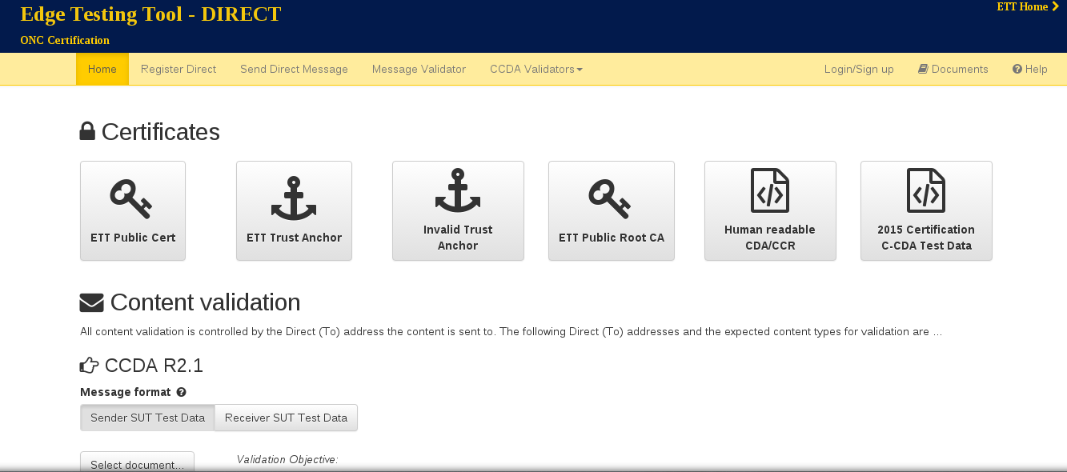
ETT Overview -- Direct

Slide 52
ETT Overview -- Direct
What’s the same (UI):
Still must register a Direct Address with at least one Contact Address in order to receive validation report.
Can still send Direct message to custom endpoint.
Standalone Direct Message Validator (for debugging)
What’s different (UI)
Instead of picklist of validation endpoints, dynamically generated because of volume.

Slide 53

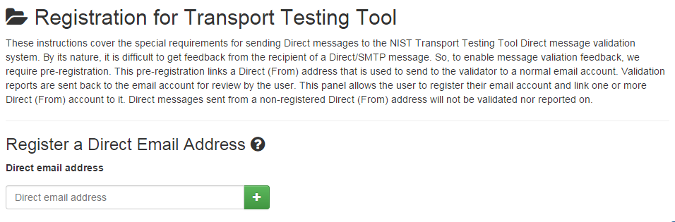

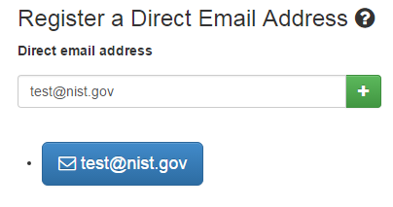
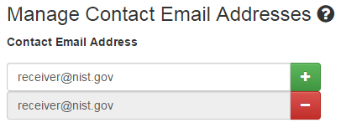
Register Direct
1
Select the “Register Direct.
4
A message will display when the email address has been successfully added.
3
Enter the contact Email address you would like to receive the validation report message.
(Note: you can enter more than one.)
2
Register your Direct Email Address.

Slide 54
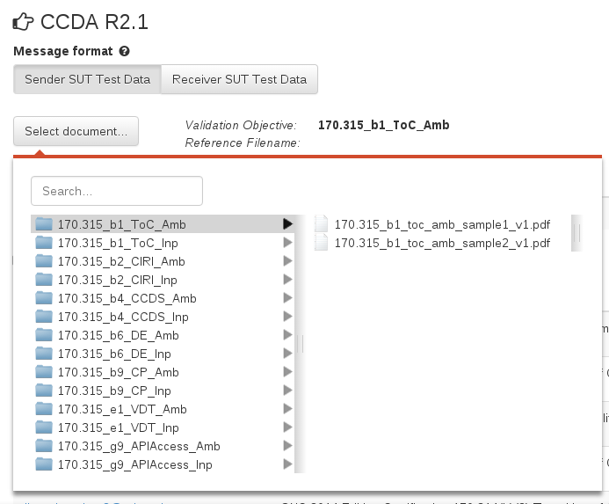
Sample Selection
Same widget to generate the validation endpoint as in MDHT standalone page.
Search feature.

Slide 55
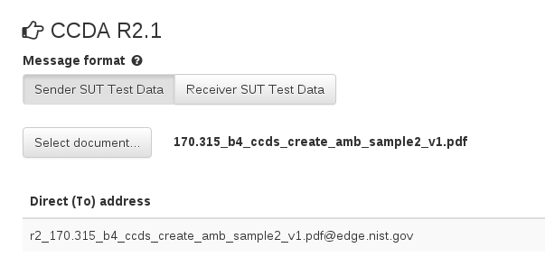
ETT Overview
The Direct To Address is dynamically generated on main Direct screen depending on validation requested.

Slide 56
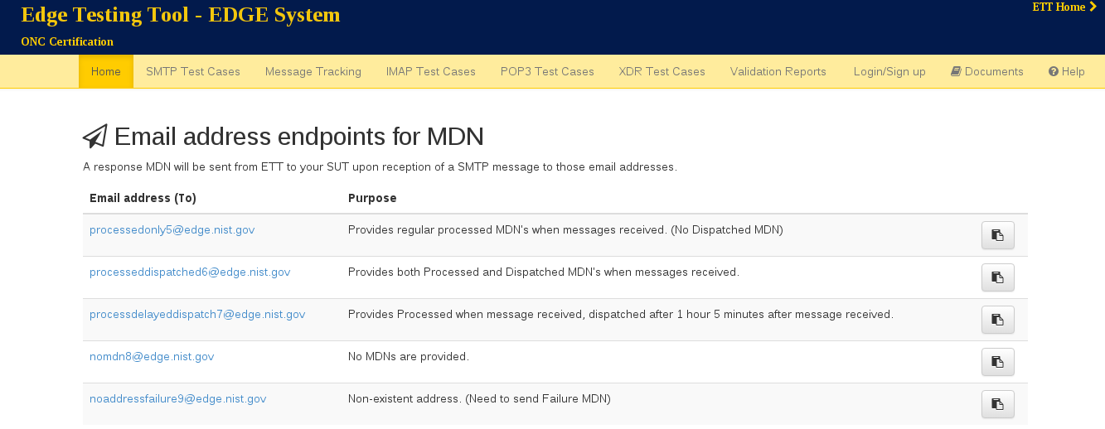
ETT Overview -- Edge

Slide 57
ETT Overview -- Edge
What’s the same
SMTP and XDR
What’s different
POP / IMAP
More negative test cases

Slide 58
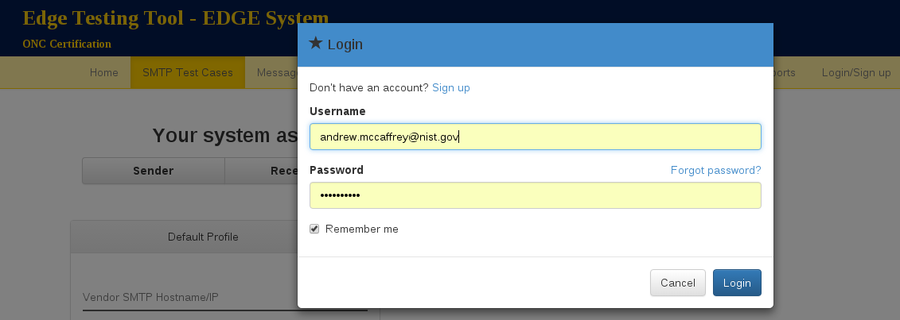
ETT Overview -- Edge
Logging in allows profile information to be saved.

Slide 59
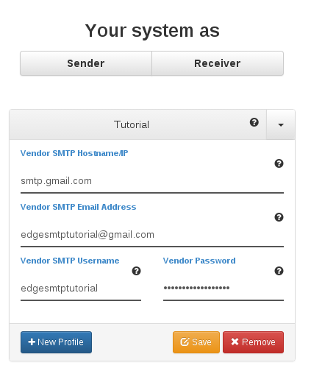
ETT Overview -- Edge
Profiles can be saved for future use.
Multiple profiles can exist.

Slide 60
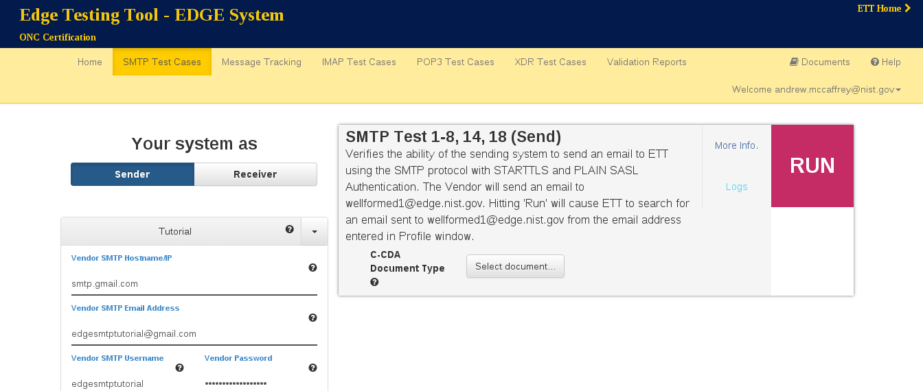
ETT Overview -- Edge (Old Test Cases)
Old test cases, same workflow. (Only difference is C-CDA widget selection for first test case.)

Slide 61
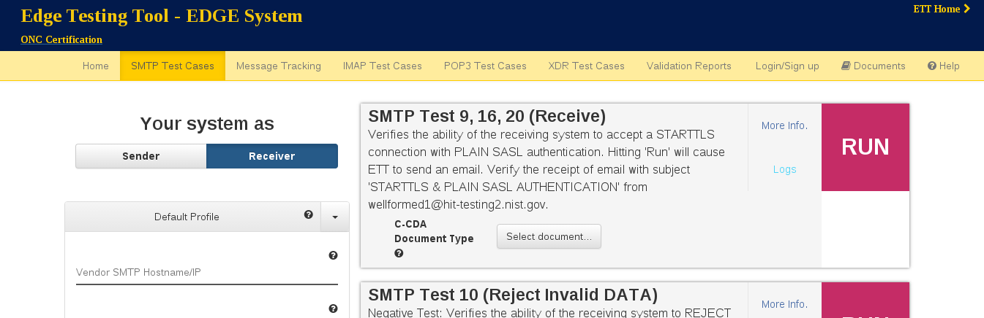
ETT Overview -- Edge Old Test Cases
Old test cases, same workflow. (Only difference is C-CDA widget selection for first test case.)

Slide 62
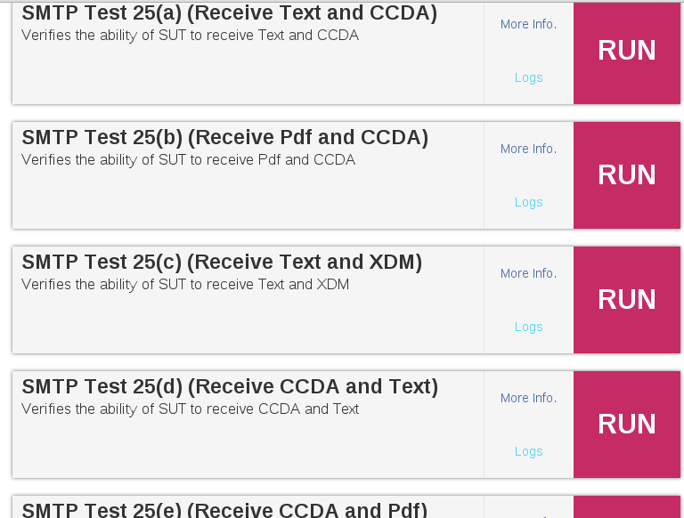
ETT Overview -- Edge More Extensive Tests

Slide 63
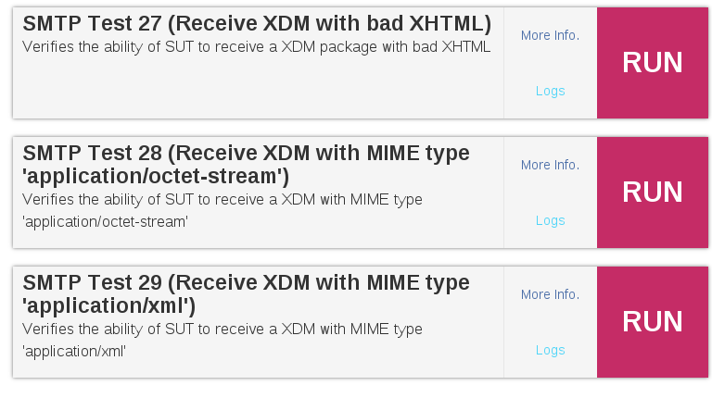
ETT Overview -- Edge More Extensive Tests

Slide 64
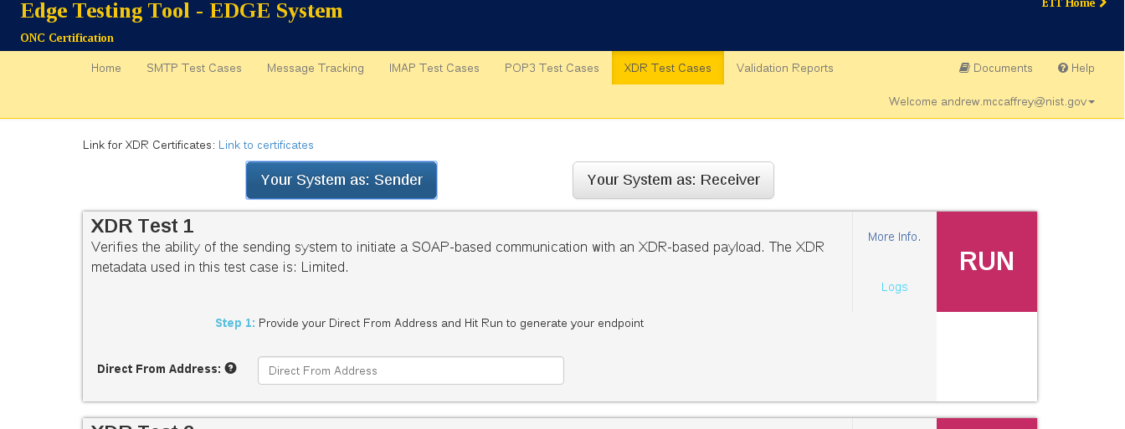
ETT Overview -- Edge More Extensive Tests
Test case from previous version. Workflow has not changed.

Slide 65
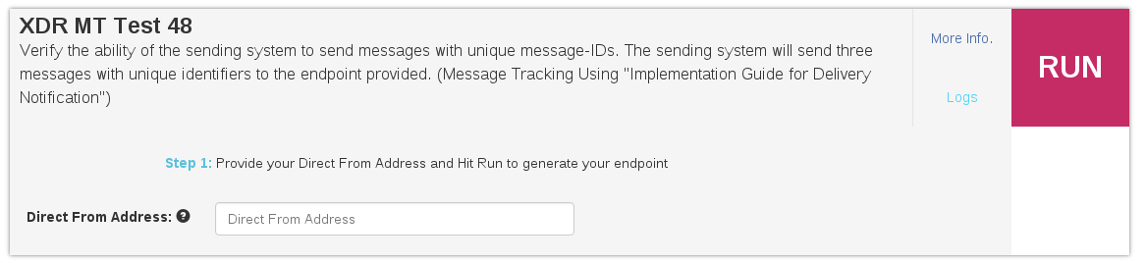
ETT Overview -- Edge More Extensive Tests
New Message Tracking test case, however the workflow has remained this same for this series. The SUT provides their Direct From Address (for ETT to track it), hits run, then obtains the endpoint and sends (in this case) three messages with unique identifiers to the displayed endpoint.

Slide 66
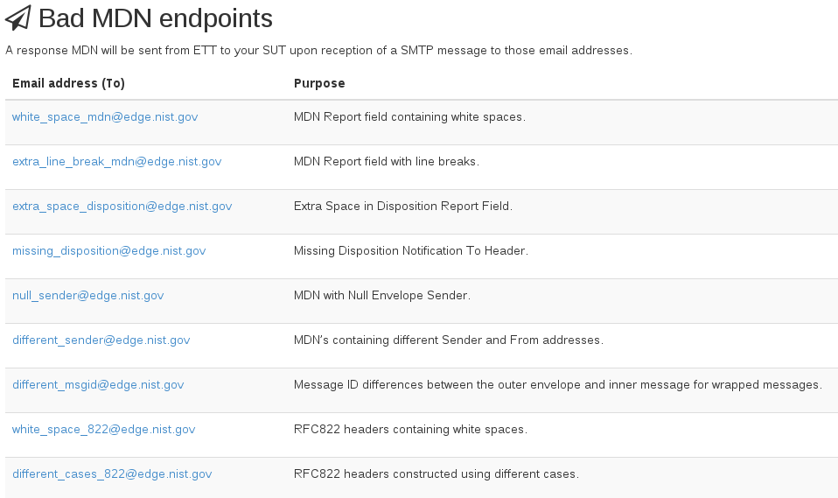
ETT Overview -- Edge Bad MDNs

Slide 67
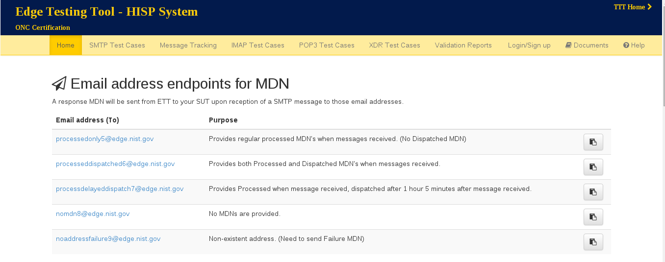
ETT Overview -- HISP

Slide 68
ETT Overview -- HISP
What’s new?
Technically everything, but…
Because a HISP must implement every protocol an Edge must, many of the test cases a HISP runs through are duplicates of what was on the Edge side.
Most of the new test cases are involved with:
Message Tracking for SMTP/POP/IMAP/XDR
Direct / XDR Translation for XDR

Slide 69
Demo of Message Tracking

Slide 70
XDR Test case 10 : Test Tool sends Direct, expects XDR

Slide 71
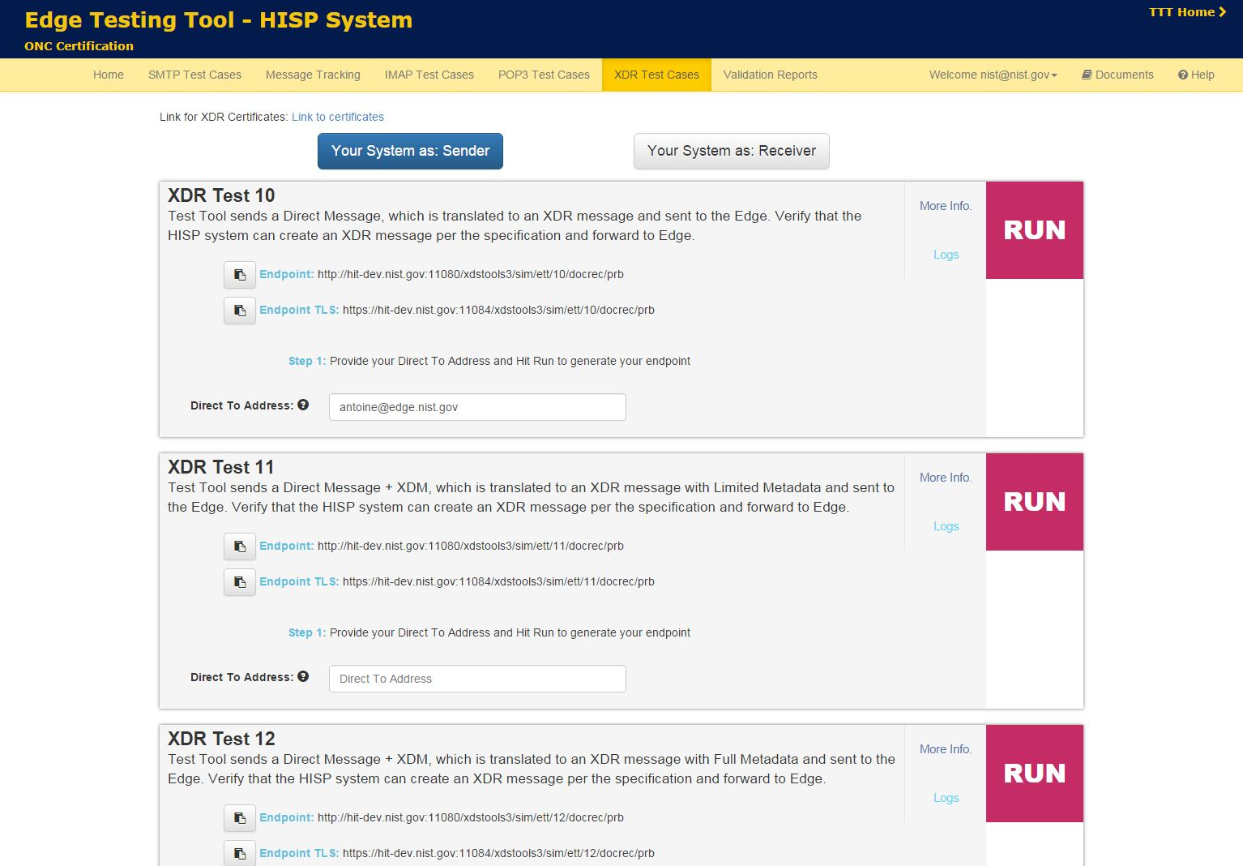
Register the XDR endpoint / direct domain name association in the SUT
Provide the SUT direct address to send to

Slide 72
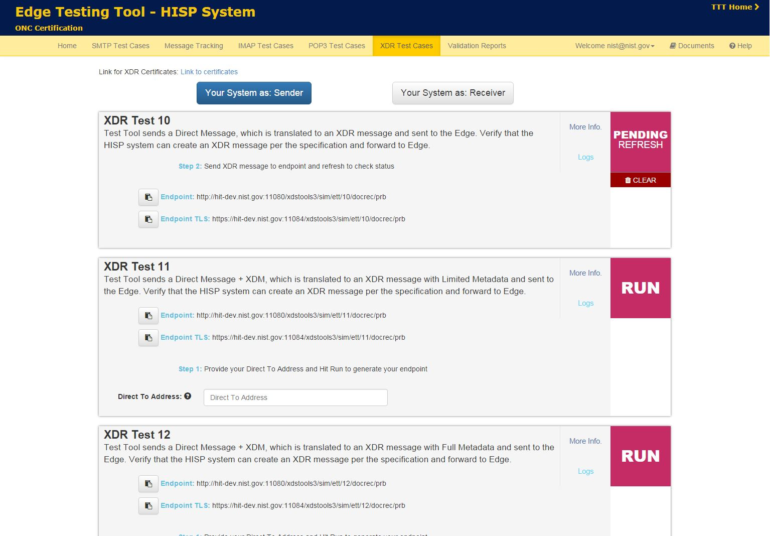
- The direct message is sent. The status stays to pending until an XDR is received

Slide 73
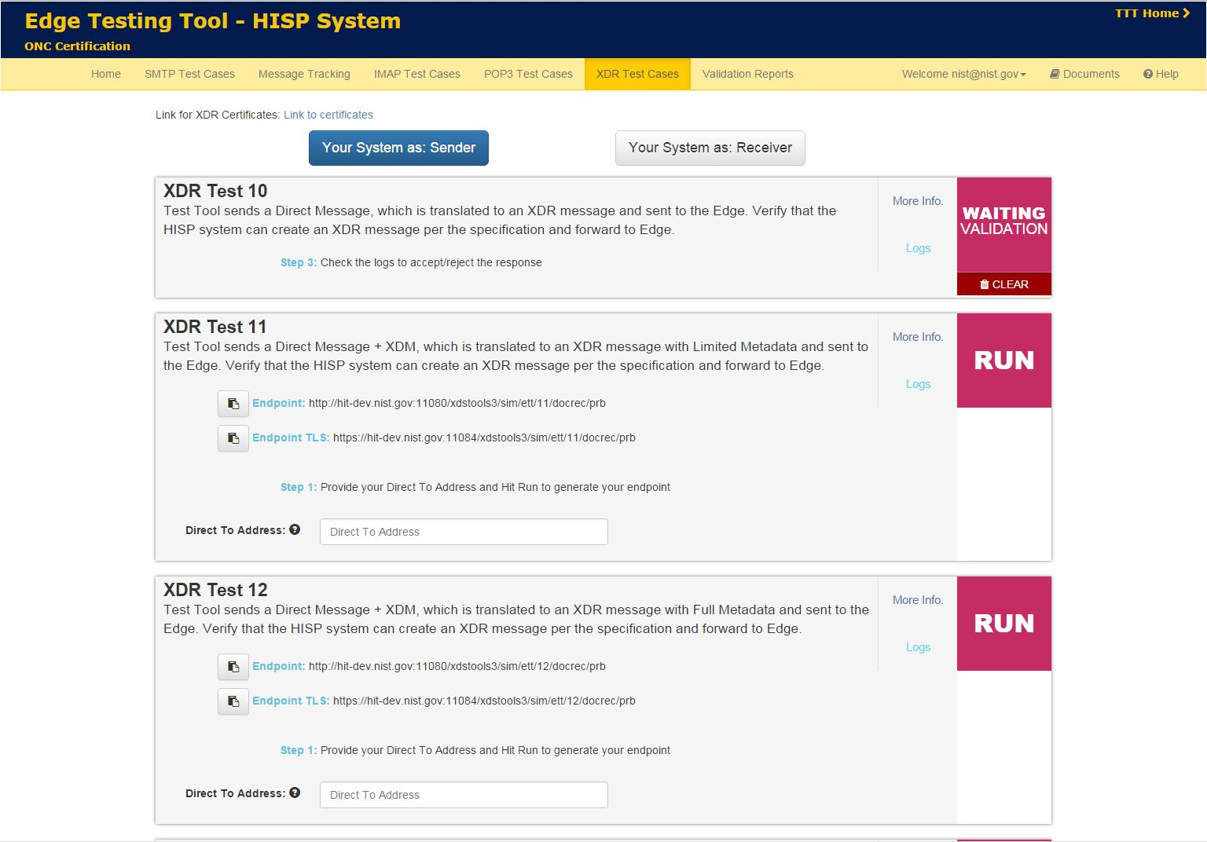
- An XDR message has been received

Slide 74
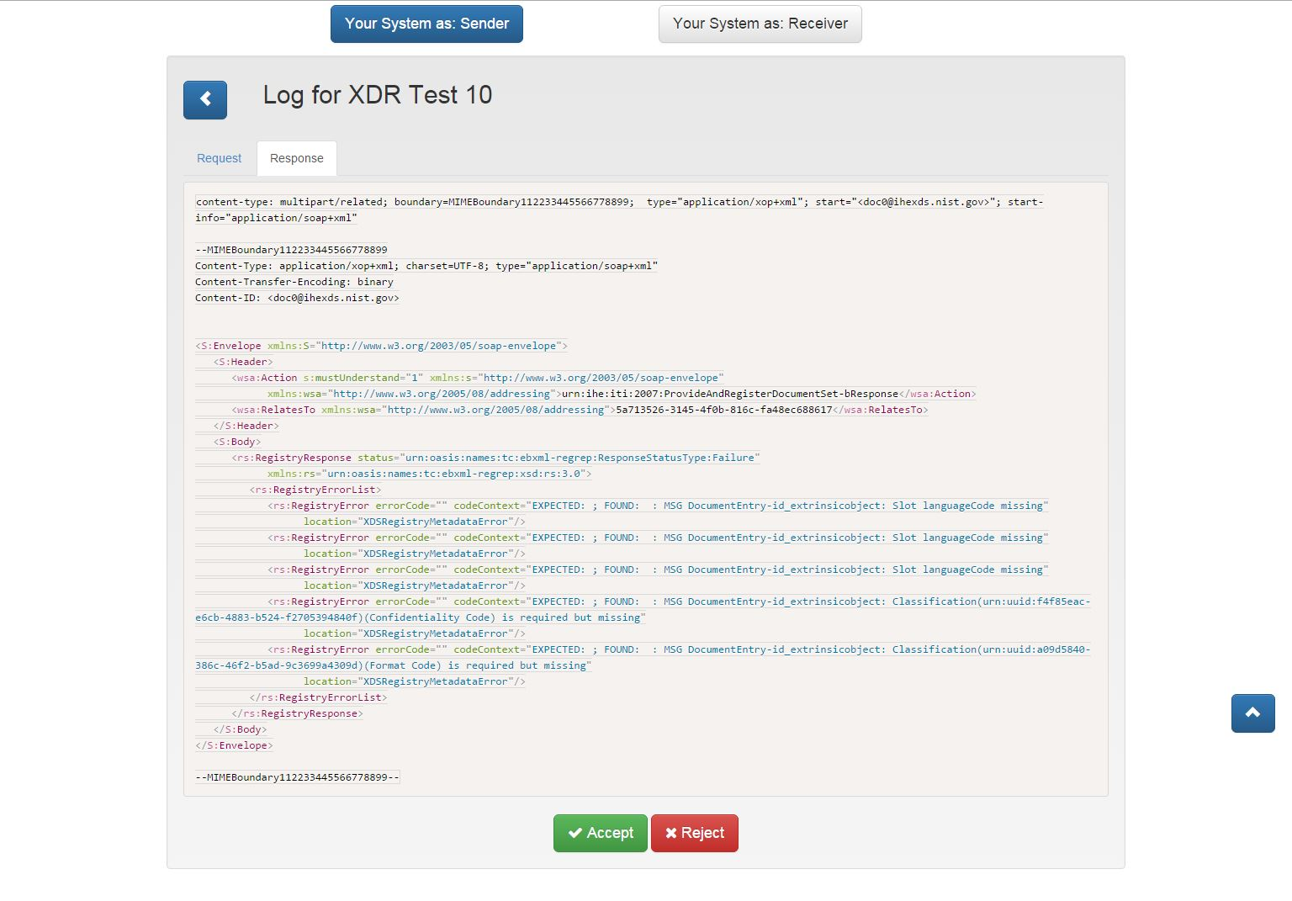
- The validation report is available for the user to validate

Slide 75
XDR Test case 13 : Test Tool sends XDR, expects Direct

Slide 76
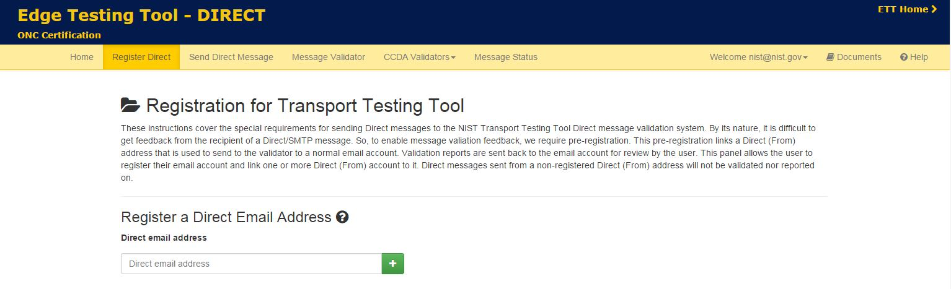
Test case 13 : system as receiver
Register direct-from address in the tool.

Slide 77
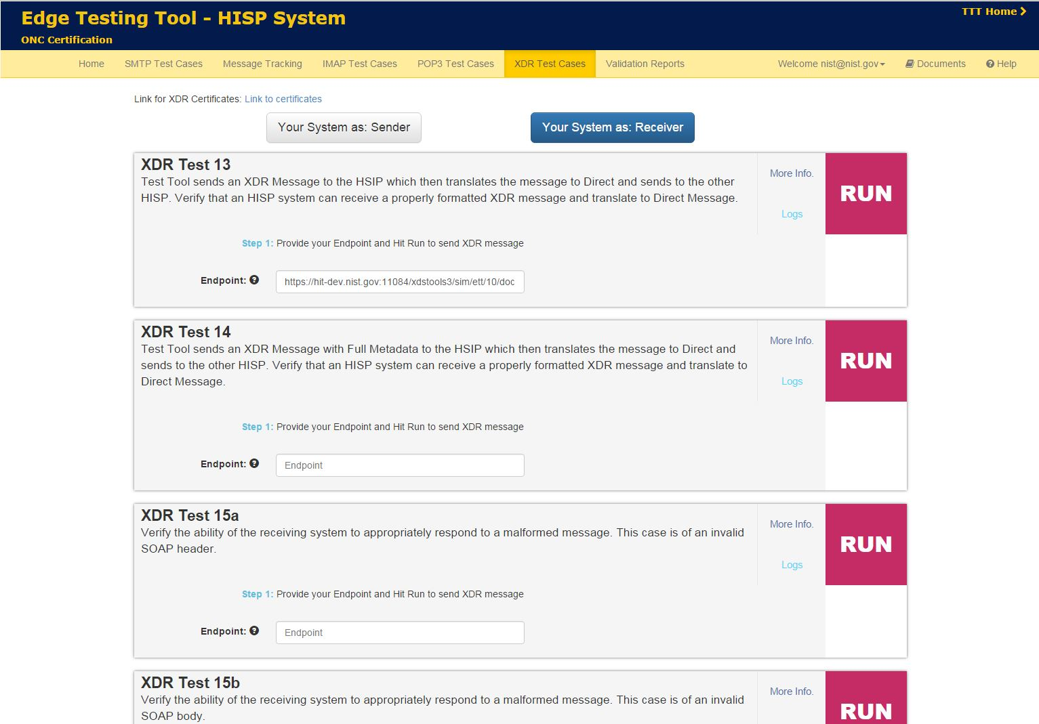
The user provides the SUT XDR endpoint

Slide 78
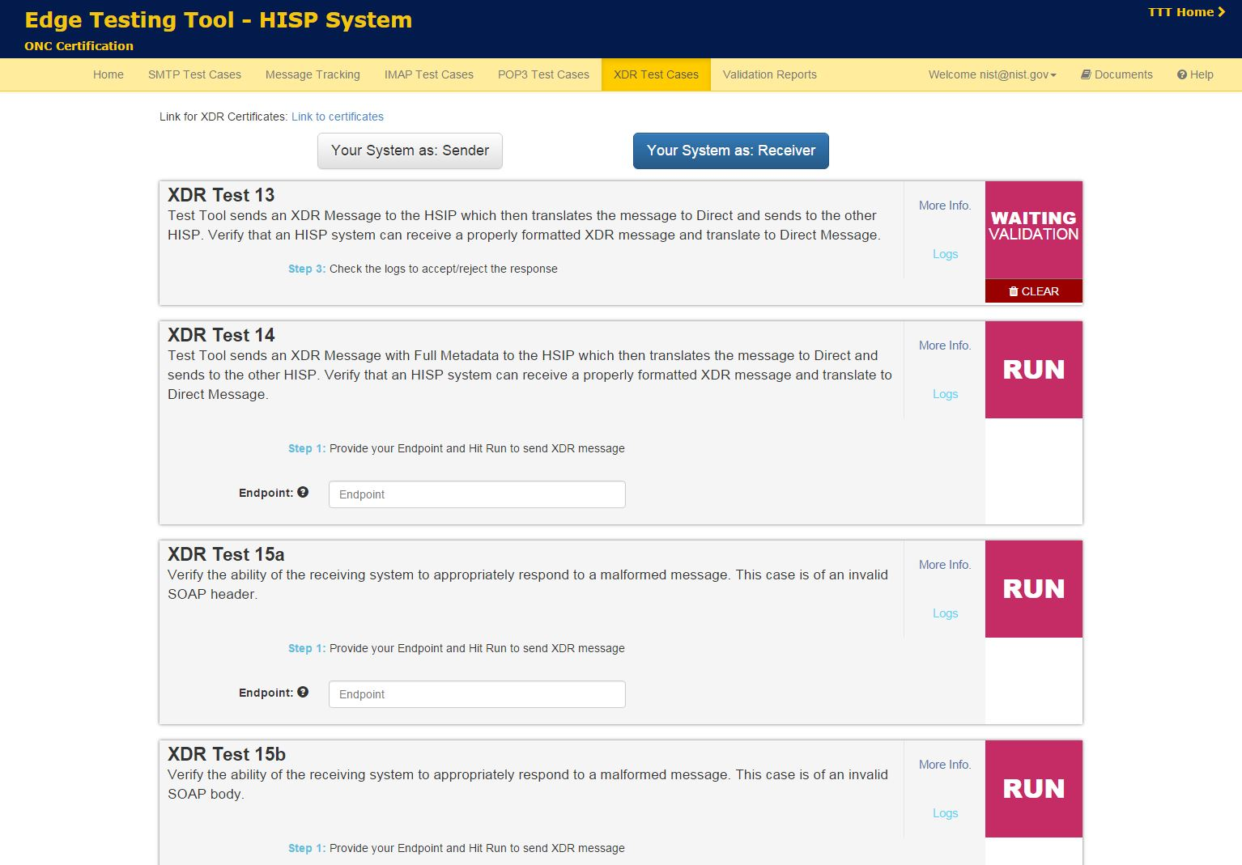
ETT sends an XDR to the provided endpoint

Slide 79

- The user can check logs to see the message sent (optional)

Slide 80

SUT sends a direct to TTT
In the Direct part of the tool, the user can check the direct has been properly sent

Slide 81

- The direct message is validated

Slide 82
ETT Overview
Please send any questions / feedback / bug reports to our Google Group:
https://groups.google.com/forum/#!forum/edge-test-tool/topics

